Slide 1

Basics of DHCP
Dynamic host configuration protocol

Slide 2
Review
Why is DHCP necessary?
What are the required DHCP parameters?
What does DORA stand for?
What messages are unicast and what messages are broadcasts?
Why are those messages broadcasts?
How do you get a new DHCP lease in Windows?

Slide 3
The Problem
Manual IP Configuration
Time consuming
Error prone
Difficult to manage

Slide 4
Why DHCP is a solution
Reliable IP configuration
Centralized IP configuration
Reduced Workload for network administration

Slide 5
What is DHCP
IPv4 only
Automatic IP configuration
Network
Subnet mask
Default gateway (default router on Cisco devices)
DNS
Domain name*

Slide 6


How it works: DORA
Client
DHCP Server
DHDPDiscover (broadcast)
Client looks for a DHCP server
DHCPOffer (unicast)
DHCP server offers lease
DHCPRequest (broadcast)
Client selects lease
DHCPAck (unicast)
Server assigns IP, client accepts IP
DHCPDiscover
DHCPOffer
DHCPRequest
DHCPAck

Slide 7
How it works: DORA Visualized
DHCPDiscover
Message
“Any DHCP servers out there?”
To
Broadcast
IP: 255.255.255.255
MAC: FFFF:FFFF:FFFF:FFFF
From
Client
Client
DHCP Server

Slide 8
How it works: DORA Visualized
DHCPOffer
Message
“I’m a DHCP server! Want 192.168.1.2 as an IP address for a week?”
To
Client (unicast)
From
DHCP Server
Client
DHCP Server

Slide 9
How it works: DORA Visualized
DHCPRequest
Message
“I would love to request 192.168.1.2 as an IP address for one week”
To
Broadcast
IP: 255.255.255.255
MAC: FFFF:FFFF:FFFF:FFFF
From
Client
Client
DHCP Server

Slide 10
How it works: DORA Visualized
DHCPAck
Message
“I acknowledge that you are 192.168.1.2 for one week”
To
Client (unicast)
From
DHCP Server
Client
DHCP Server

Slide 11
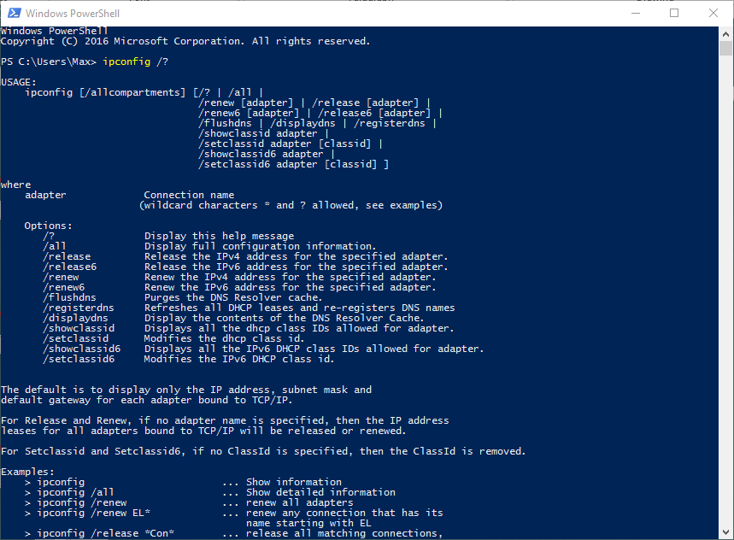
Helpful DHCP Tools: Windows
ipconfig /release – releases the IP address for the specified adapter.
Ipconfig /renew – Renew the IP address for the specified adapter.

Slide 12
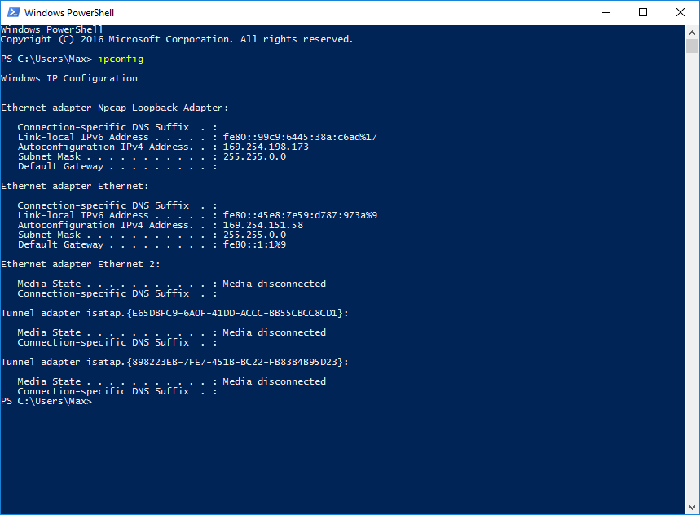
DHCP Troubleshooting
If you have a 169.x.x.x address, you were not able to find a DHCP server.
`

Slide 13
Review
Why is DHCP necessary?
What are the required DHCP parameters?
What does DORA stand for?
What messages are unicast and what messages are broadcasts?
Why are those messages broadcasts?
How do you get a new DHCP lease in Windows?

Slide 14
Review
Why is DHCP necessary?
Reliable, centralized, reduced admin workload
What are the required DHCP parameters?
Network, subnet, default gateway, DNS
What does DORA stand for?
DHCPDiscover, Offer, Request, Ack
What messages are unicast and what messages are broadcasts?
Discover and Request
Why are those messages broadcasts?
Discover: to search for DHCP servers
Request: so other DHCP servers can account for the lease
How do you get a new DHCP lease in Windows?
ipconfig /renew

